Slide 1

DEEP LEARNING IN COMPUTER VISION and NATURAL LANGUAGE PROCESSING
Dr. Amir Yavariabdi
amir.yavariabdi@bth.se
1

Slide 2
Outline: Part I
Introduction to Computer Vision
Overview of computer vision as a field of AI
Importance of computer vision in interpreting and analyzing visual data
Challenge of computer vision
History of computer vision
Tasks in Computer Vision using Deep Learning
Image classification
Object localization
Segmentation
Other applications

Slide 3
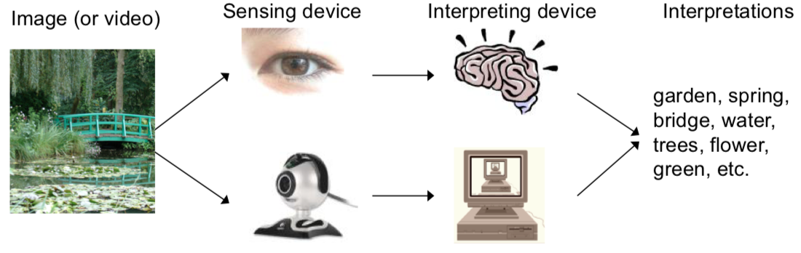
What is Computer Vision?
Computer vision is a field of Artificial Intelligence (AI) that enables computers and systems to:
interpret, understand, and analyze visual data and
extract meaningful information from digital images, videos, and other visual inputs.
Sensing Device
Interpreting Device
Scene
Interpretations
?

Slide 4
What is Computer Vision?
Computer vision is a field of Artificial Intelligence (AI) that enables computers and systems to:
interpret, understand, and analyze visual data and
extract meaningful information from digital images, videos, and other visual inputs.
Sensing Device
Interpreting Device
Scene
Interpretations

Slide 5
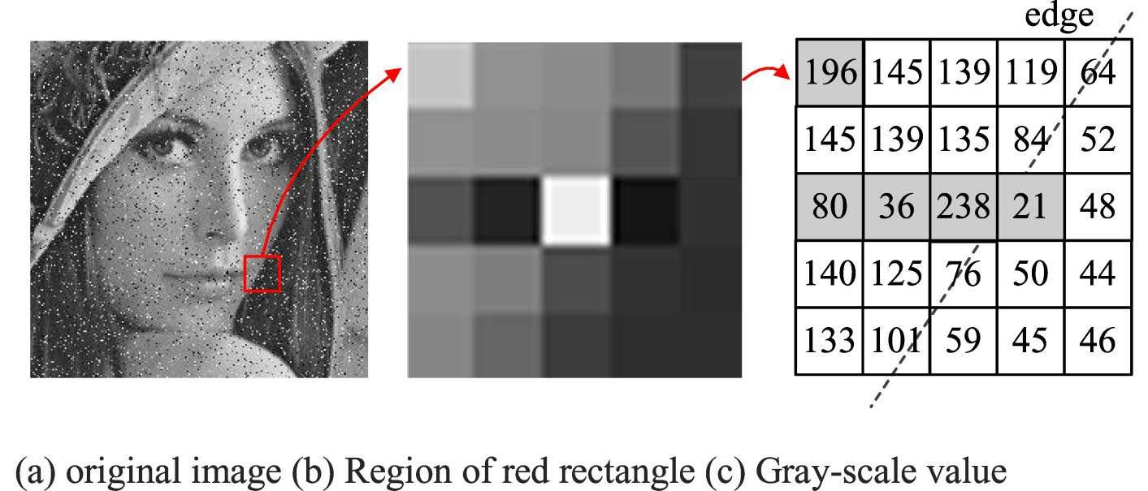
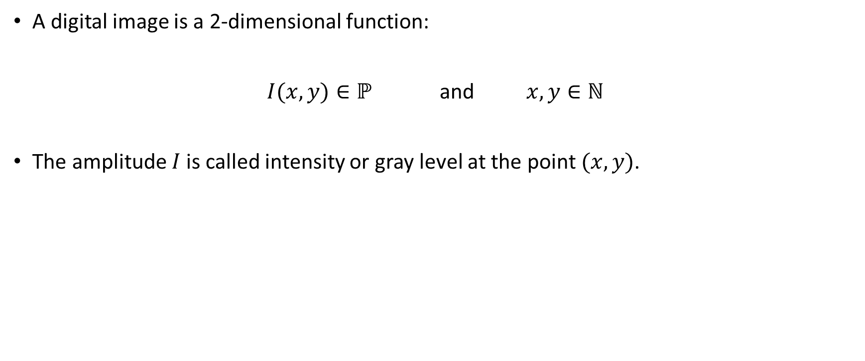
What is a Digital Image?
A digital image is a 2-dimensional function:
$I(x,y)∈ℙ$ and $x,y∈ℕ$
The amplitude $I$ is called intensity or gray level at the point $(x,y)$.
Set of intensity values
Image coordinates are integers

Slide 6
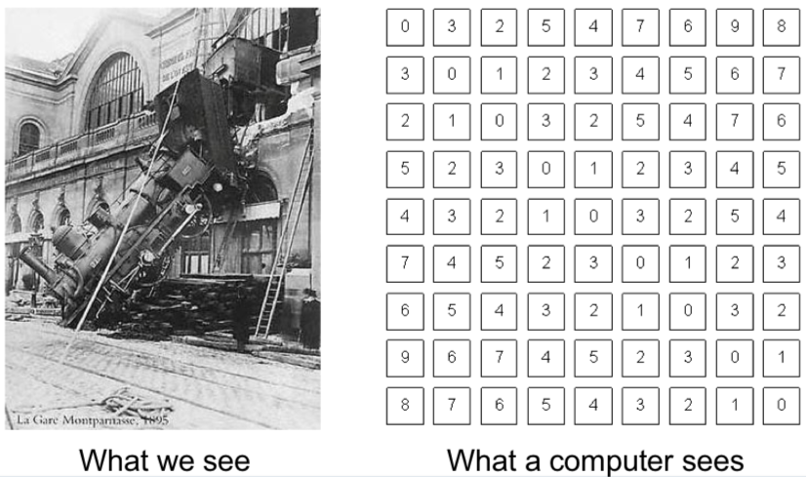
The Goal of the Computer Vision
Replicate the human vision system using advanced algorithms and mathematical models.
This allows computers to bridge the gap between pixels and their various dimensions of meaning, by automatically extracting relevant information.

Slide 7
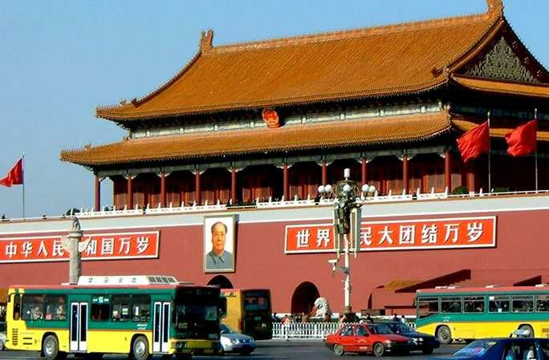
Unlocking Insights: Extracting Relevant Information within Visual Data
Extract semantic information from an image
Image semantic meaning can be divided into three layers:
Bottom Layer: extracts colors, texture, shape, etc.
Image credit: Fei-Fei, Fergus

Slide 8
Unlocking Insights: Extracting Relevant Information within Visual Data
Extract semantic information from an image
Image semantic meaning can be divided into three layers:
Object Layer: considers the problems about the objects and objects’ space in images.
Sky
Building
Flag
Flag
Streetlamp
Face
Wall
Banner
Bus
Bus
Car
Image credit: Fei-Fei, Fergus

Slide 9
Unlocking Insights: Extracting Relevant Information within Visual Data
Extract semantic information from an image
Image semantic meaning can be divided into three layers:
Concept Layer: solves the meaning expressed by images through scene, knowledge, and emotion.
Outdoor
City
Traffic
…
Image credit: Fei-Fei, Fergus

Slide 10
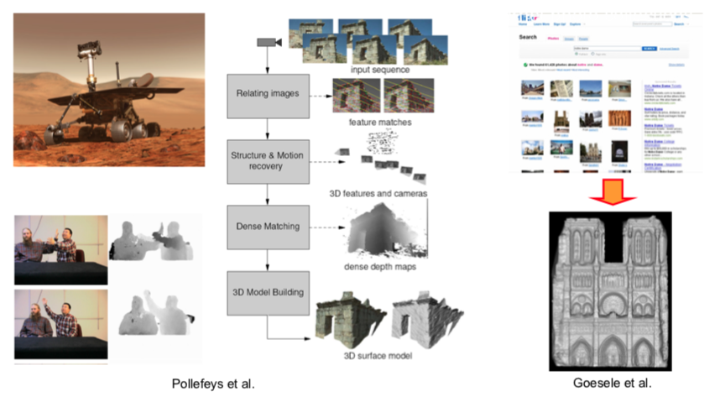
Unlocking Insights: Extracting Relevant Information within Visual Data
Extract metric 3D information from images.

Slide 11
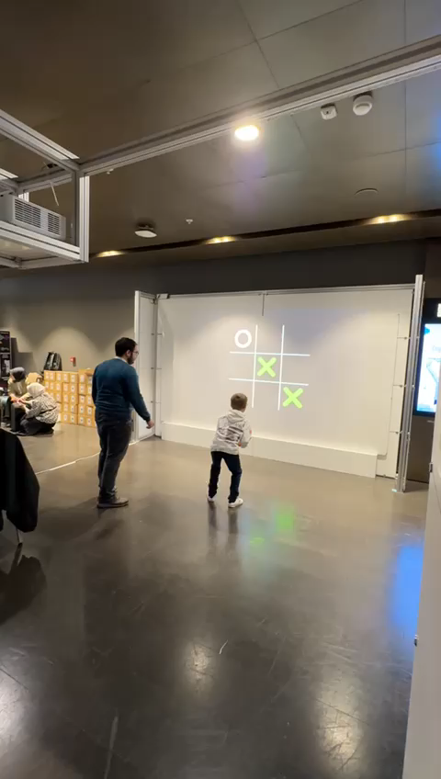
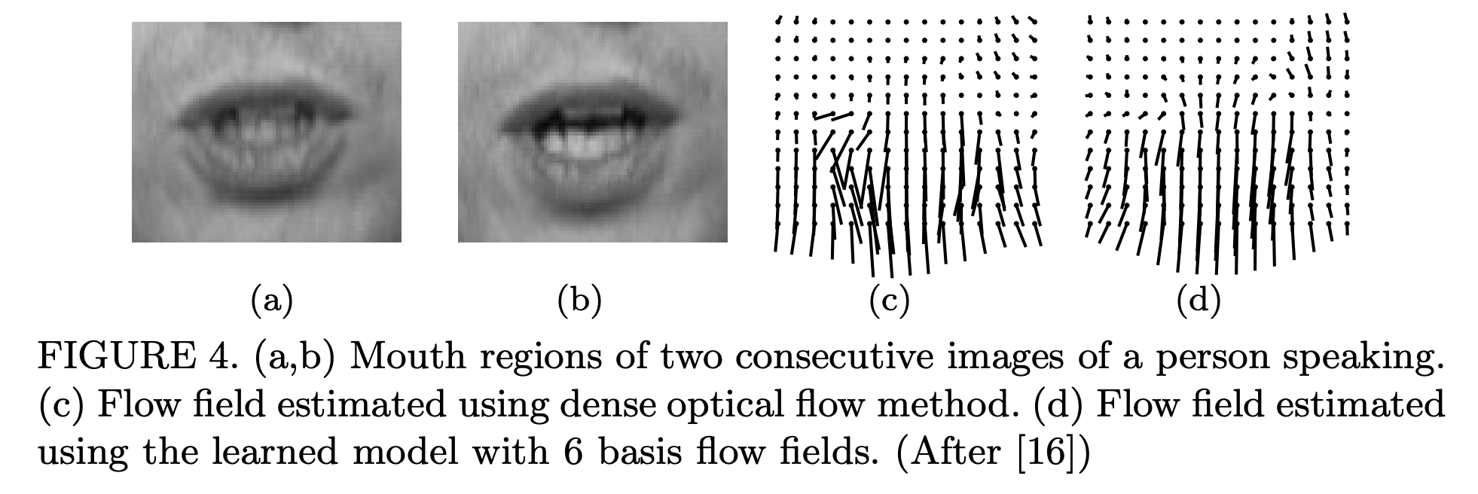
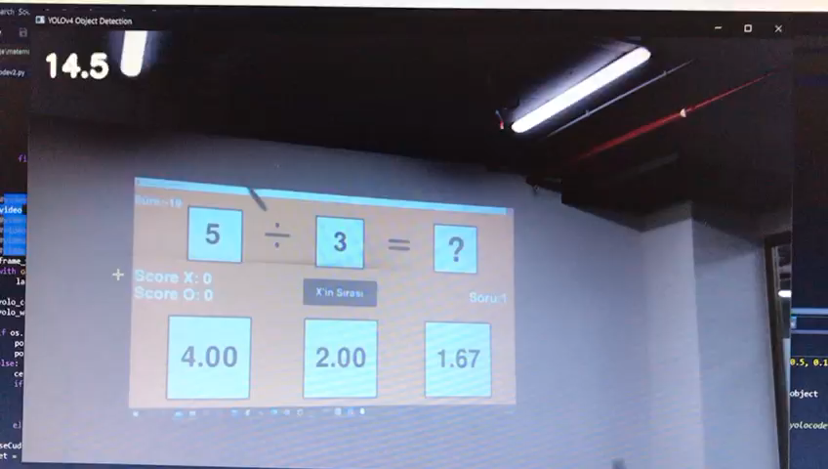
Unlocking Insights: Extracting Relevant Information within Visual Data
Extract temporal Information in video frames:
In video analysis, temporal information refers to the changes and dynamics occurring over time, including motion detection, tracking, and action recognition.
Taken from: https://paperswithcode.com/task/optical-flow-estimation
Motion detection and tracking

Slide 12

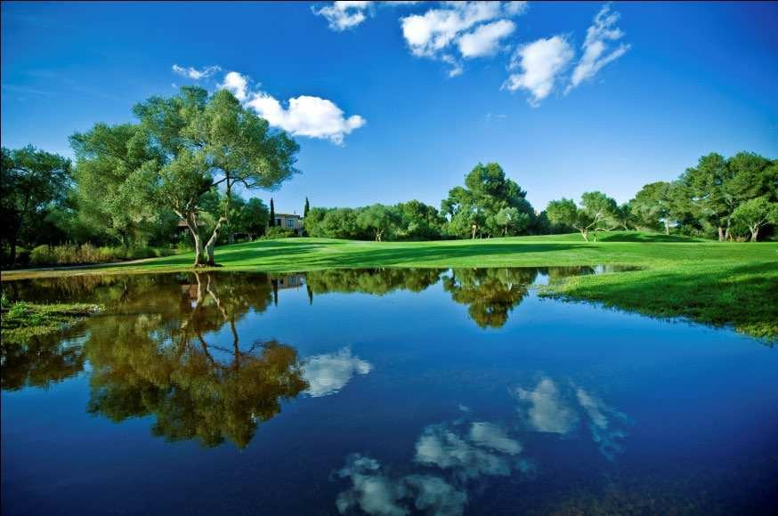
Challenge of Computer Vision
Helping computers to "see" has proven to be a surprisingly challenging task.
Over the last four decades, numerous research efforts have been undertaken, yet despite this, we are still far from being able to build a general-purpose "seeing machine."

Slide 13
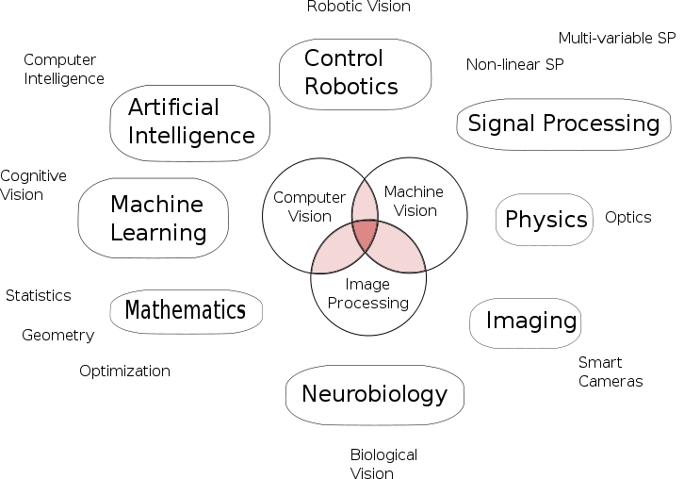
Challenge of Computer Vision
Computer vision is a multidisciplinary field.
Computer Graphics
Taken from wiki

Slide 14
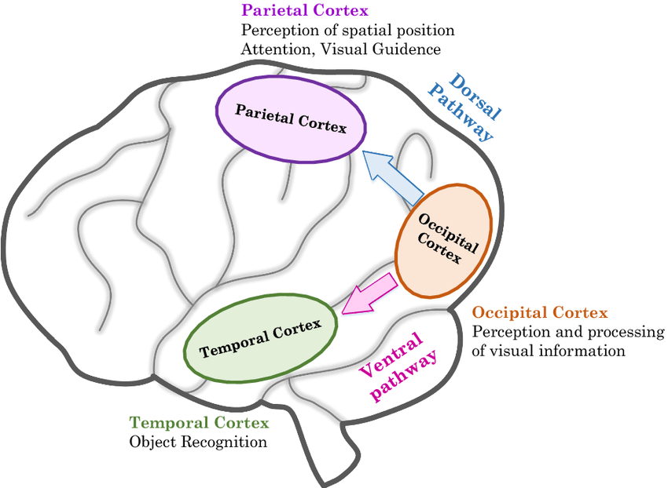
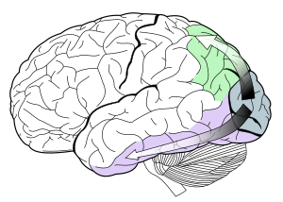
Challenge of Computer Vision
We still lack a comprehensive understanding of how human vision operates.
Studying biological vision requires an understanding of the perception organs like:
the eyes, and
the interpretation of the perception within the brain.
Significant progress has been made, both in charting the process and in terms of discovering the tricks and shortcuts used by the system,
However, like any study that involves the brain, there is a long way to go.
Taken from: https://www.lincuna.com.pe/cortex-Radiology-Reference-Article-1118642.html

Slide 15
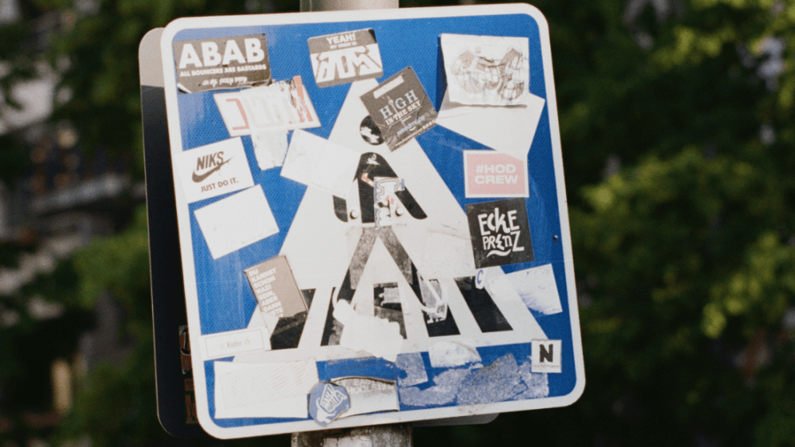
Challenge of Computer Vision
The existence of inherent complexity in the visual world.
A given object may be seen from any orientation, in any lighting conditions, with any type of occlusion from other objects, and so on.
A given object may exhibit intra-class variations.
A true vision system must be able to see in any of an infinite number of scenes and still extract something meaningful.
Existing algorithms and models work well for tightly constrained problems.
Taken from: Karpathy, A., and Johnson, J. Cs231n convolutional neural networks for visual recognition-transfer learning. https://cs231n.github.io/.

Slide 16
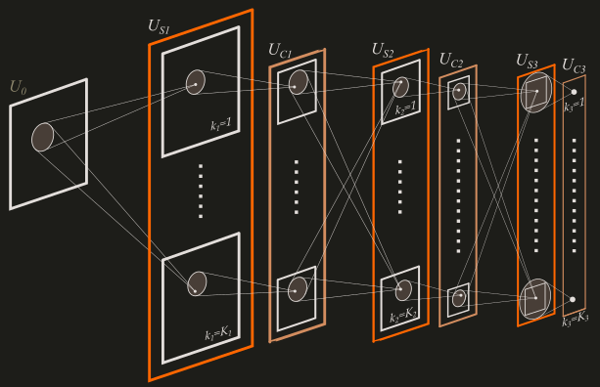
History of Computer Vision: Transition to Deep Learning
1959-Introduction of Digital Image Scanner: The first digital image scanner enabled computers to convert images into numerical grids, laying the foundation for early attempts at computer vision.
1980-Invention of Neocognition: Japanese computer scientist Kunihiko Fukushima developed neocognition, a precursor to modern convolutional neural networks (CNNs).
S-cells are feature-extracting cells.
After the learning process these cells can extract features from input patterns.
Simple features (like lines, edges) are extracted in the lower stages, global features (composite shapes) are extracted in the higher stages.
C-cells provide tolerance from positional shift.
C-cells are less sensitive to shifts in the positions of the input pattern. The final layer of the model, the final pattern recognition layer, is a C-cell.
Architecture of Neocognition

Slide 17
History of Computer Vision: Transition to Deep Learning
1990-2012-Era of Feature Engineering: Feature engineering was widely used to manually construct features for training machine learning algorithms in visual tasks, although it had limitations in handling complex data.
The widely known and most commonly feature extraction methods are:
Harris Corner Detection: Detect corners in an input image.
Scale-Invariant Feature Transform (SIFT): SIFT is used to detect corners, blobs, circles, and so on. It is also used for scaling an image.
Speeded-up Robust Features (SURF): SURF algorithm is simply an upgraded version of SIFT.
Histogram of Oriented Gradients (HoG): Count the occurrence of gradient orientation in localized portions of an image.

Slide 18
History of Computer Vision: Transition to Deep Learning
2012-Breakthrough with AlexNet: The AlexNet algorithm achieved a significant breakthrough by winning the ImageNet Large Scale Visual Recognition Challenge, surpassing competitors by 10%.
This marked the transition from hand-engineered features to deep learning, demonstrating the power of neural networks in computer vision tasks.
2012-Present-Rise of Deep Learning: Deep learning, particularly convolutional neural networks (CNNs), has revolutionized computer vision, enabling more efficient, precise, and reliable recognition of objects and patterns.
With the continuous development of deep learning networks, computer vision approaches are reaching human-level performance and beyond.

Slide 19
Promise of Deep Learning for Computer Vision
Automatic Feature Extraction
Features can be automatically learned and extracted from raw image data.
Model Reuse
Learned features can be reused across tasks.
Superior Performance
Techniques demonstrate better skill on challenging tasks.
General Method
A single general method can be used on a range of related tasks.

Slide 20
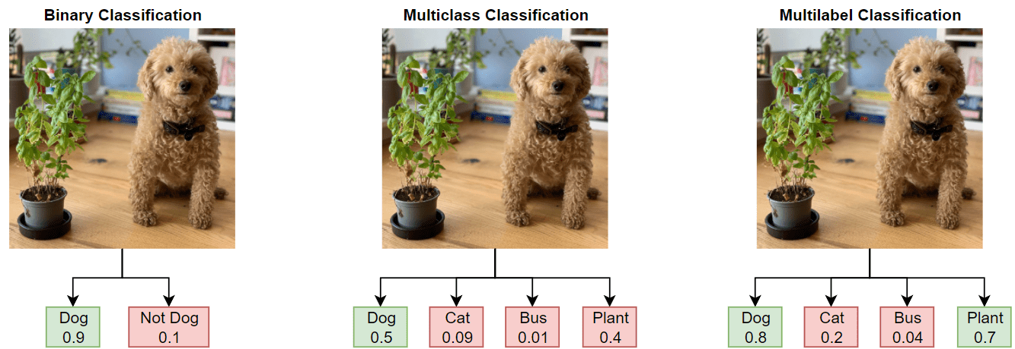
Tasks in Computer Vision
Classification: Image classification involves assigning a label to an entire image.
Types of image classification include:
Binary classification: classifying the input image into two mutually exclusive categories.
Multiclass classification: classifying the input image into more than two classes or categories.
Multi-label classification: each input image may be associated with multiple labels simultaneously.

Slide 21
Tasks in Computer Vision
For image classification, some common evaluation metrics are:
accuracy,
precision,
recall, and
confusion matrix.

Slide 22
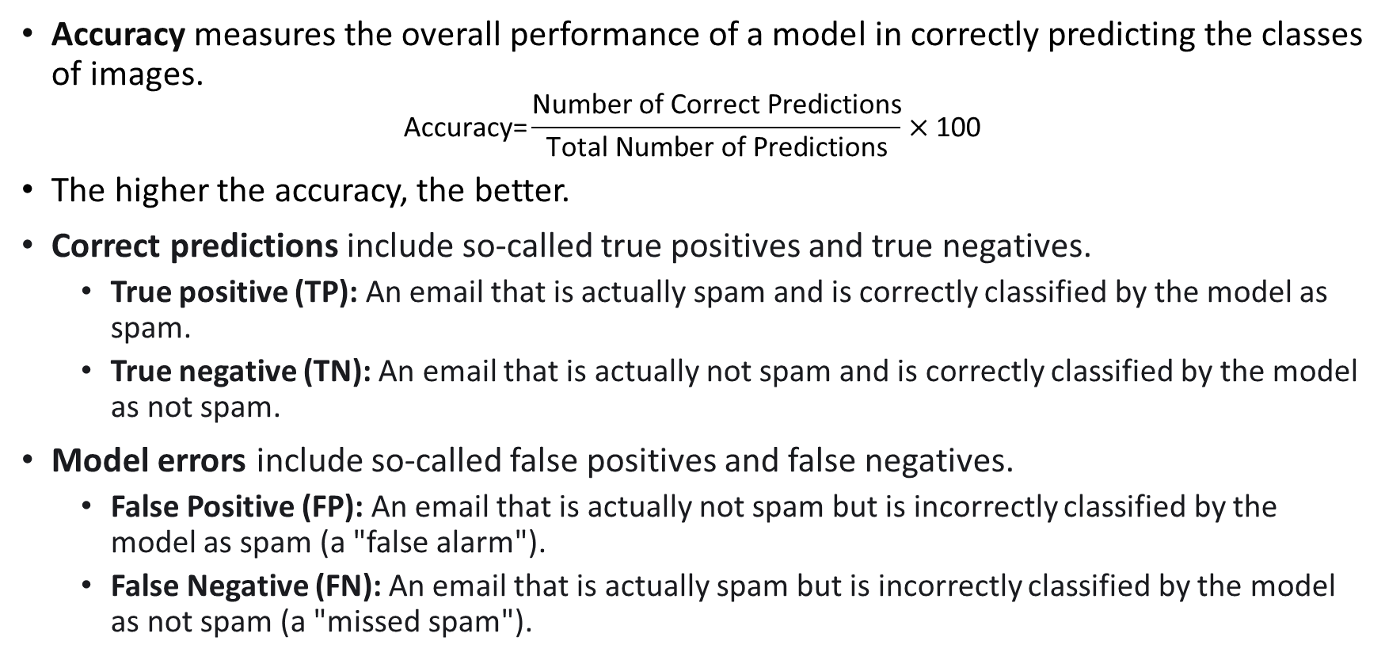
Tasks in Computer Vision
Accuracy measures the overall performance of a model in correctly predicting the classes of images.
$$\text{A}\text{ccuracy}\text{=}\frac{\text{Number} \text{of} \text{Correct} \text{Predictions}}{\text{Total} \text{Number} \text{of} \text{Predictions}}×\text{100}$$
The higher the accuracy, the better.
Correct predictions include so-called true positives and true negatives.
True positive (TP): An email that is actually spam and is correctly classified by the model as spam.
True negative (TN): An email that is actually not spam and is correctly classified by the model as not spam.
Model errors include so-called false positives and false negatives.
False Positive (FP): An email that is actually not spam but is incorrectly classified by the model as spam (a "false alarm").
False Negative (FN): An email that is actually spam but is incorrectly classified by the model as not spam (a "missed spam").

Slide 23
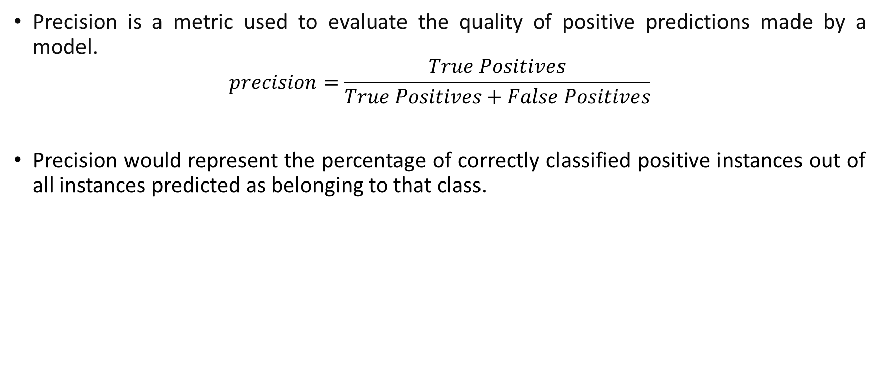
Tasks in Computer Vision
Precision is a metric used to evaluate the quality of positive predictions made by a model.
$$precision=\frac{True Positives}{True Positives+False Positives}$$
Precision would represent the percentage of correctly classified positive instances out of all instances predicted as belonging to that class.
Notes:
Evaluate the correctness of the model.

Slide 24
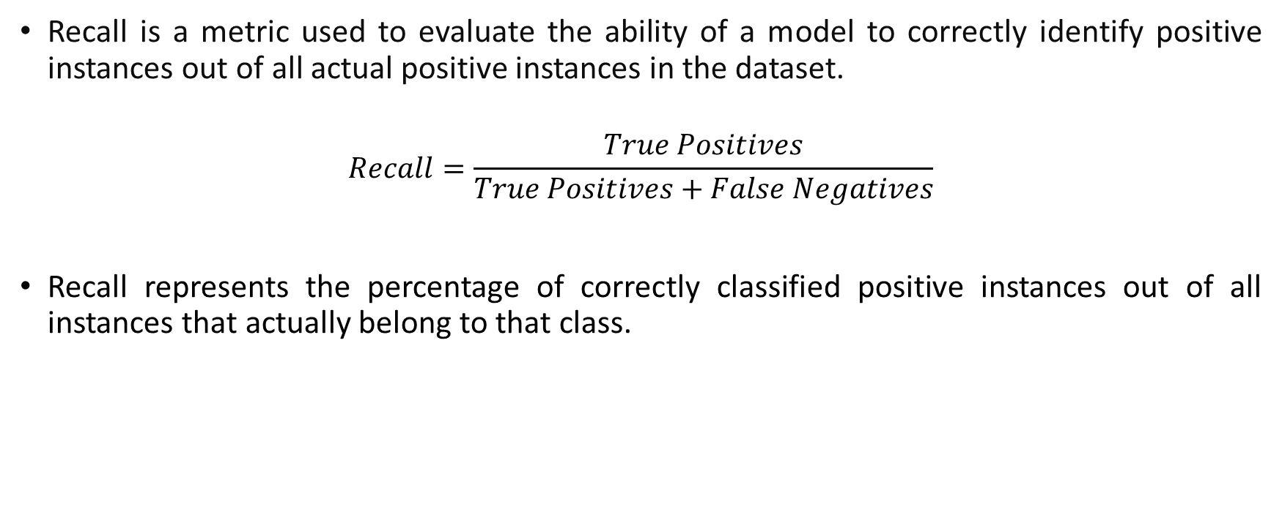
Tasks in Computer Vision
Recall is a metric used to evaluate the ability of a model to correctly identify positive instances out of all actual positive instances in the dataset.
$$Recall=\frac{True Positives}{True Positives+False Negatives}$$
Recall represents the percentage of correctly classified positive instances out of all instances that actually belong to that class.

Slide 25
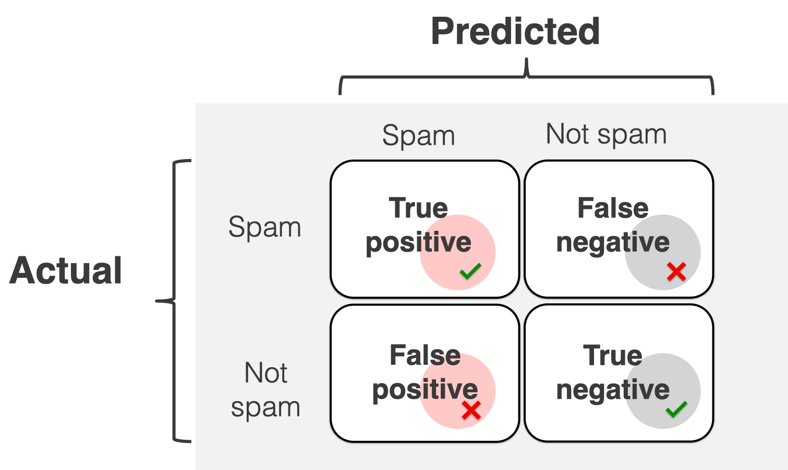
Tasks in Computer Vision
Using the confusion matrix, we can visualize all 4 different outcomes (TP, TN, FP, and FN) in a single table.
It presents a summary of the predictions made by the model compared to the actual ground truth across different classes.

Slide 26
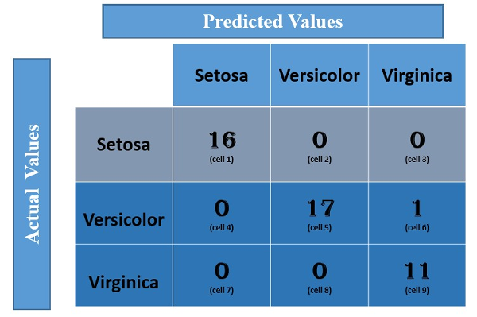
Tasks in Computer Vision
In the multi-class classification problem, we cannot get TP, TN, FP, and FN values directly as in the binary classification problem.
We need to calculate for each class.
Let us calculate the TP, TN, FP, and FN values for the class Setosa:
TP: The actual value and predicted value should be the same. So concerning Setosa class, the value of cell 1 is the TP value.
FN: The sum of values of corresponding rows except for the TP value. FN = (cell 2 + cell3)= (0 + 0)= 0
FP: The sum of values of the corresponding column except for the TP value. FP = (cell 4 + cell 7)= (0 + 0)= 0
TN: The sum of values of all columns and rows except the values of that class that we are calculating the values for.
TN = (cell 5 + cell 6 + cell 8 + cell 9) = 17 + 1 +0 + 11= 29

Slide 27
Tasks in Computer Vision
In the multi-class classification problem, we cannot get TP, TN, FP, and FN values directly as in the binary classification problem.
We need to calculate for each class.
Let us calculate the TP, TN, FP, and FN values for the class Versicolor:
TP: 17 (cell 5)
FN : 0 + 1 = 1 (cell 4 +cell 6)
FP : 0 + 0 = 0 (cell 2 + cell 8)
TN : 16 +0 +0 + 11 =27 (cell 1 + cell 3 + cell 7 + cell 9).

Slide 28
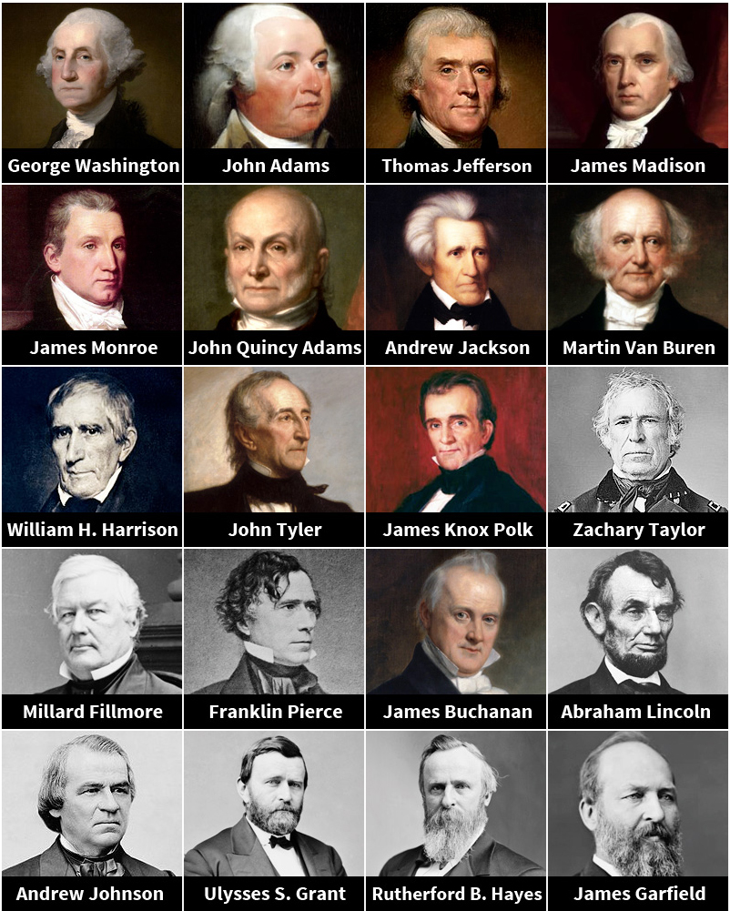
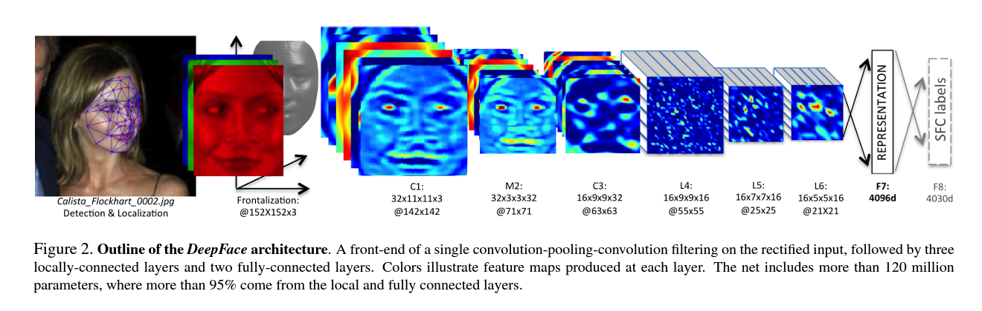
Image Classification: Face Verification
DeepFace: Closing the Gap to Human-Level Performance in Face Verification, (DeepFace), by Facebook AI Research, and Tel Aviv University, 2014, CVPR
Well-known Face Datasets:
Social Face Classification (SFC)
Labeled Faces in the Wild database (LFW)
YouTube Faces (YTF)
MS-Celeb-1M
MegaFace

Slide 29
DeepFace: Closing the Gap to Human-Level Performance in Face Verification
Face image is under 2D and 3D face alignments.
The aligned face is input to DeepFace network for face verification.
Network Architecture:
The purpose of these three layers is to extract low-level features, like simple edges and texture.

Slide 30
DeepFace: Closing the Gap to Human-Level Performance in Face Verification
Face image is under 2D and 3D face alignments.
The aligned face is input to DeepFace network for face verification.
Network Architecture:
The purpose of these three layers is to extract low-level features, like simple edges and texture.
Max-pooling layer: make the output of convolution networks more robust to local translations.

Slide 31
DeepFace: Closing the Gap to Human-Level Performance in Face Verification
Why are not there more max-pooling layers?
several levels of pooling would cause the network to lose information about the precise position of detailed facial structure and micro-textures.
The purpose of these three layers is to extract low-level features, like simple edges and texture.

Slide 32
DeepFace: Closing the Gap to Human-Level Performance in Face Verification
The L subsequent layers are locally connected.
This means that the weights for the convolution operation can vary depending on the location within the feature map.
For example, areas between the eyes and the eyebrows exhibit very different appearance and have much higher discrimination ability compared to areas between the nose and the mouth.

Slide 33
DeepFace: Closing the Gap to Human-Level Performance in Face Verification
Fully Connected Layers:
Capture correlations between features from distant parts of face images.
e.g., position and shape of eyes and position and shape of mouth.
The output of the last fully-connected layer is fed to a softmax which produces a distribution over the class labels.

Slide 34
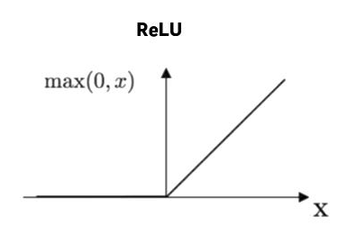
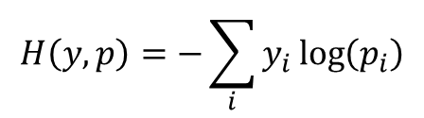
DeepFace: Closing the Gap to Human-Level Performance in Face Verification
Activation Function:
ReLU is used.
Regularization:
Dropout applied only to the first fully-connected layer.
Loss Function:
Cross entropy: it indicates the distance between what the model believes the output distribution should be, and what the original distribution really is.
$$H\left(y,p\right)=−\sum_{i}{y_{i}\log\left(p_{i}\right)}$$

Slide 35
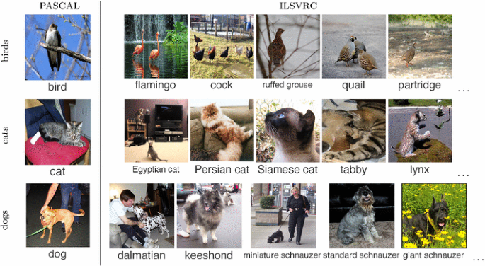
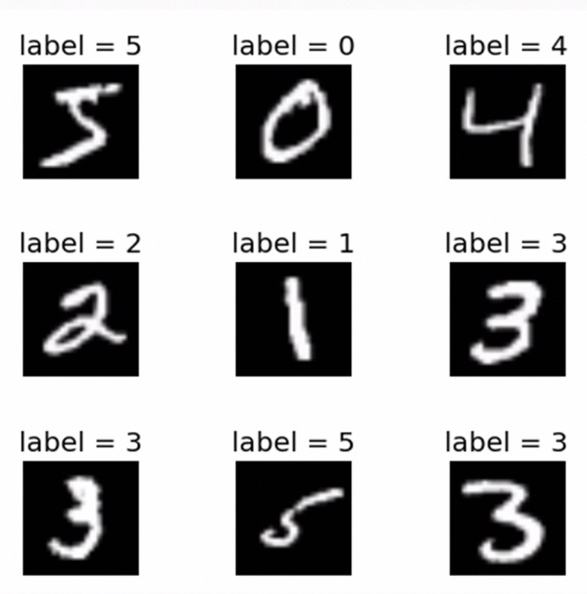
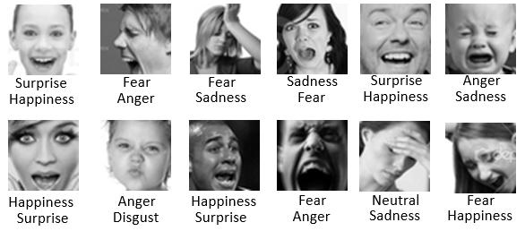
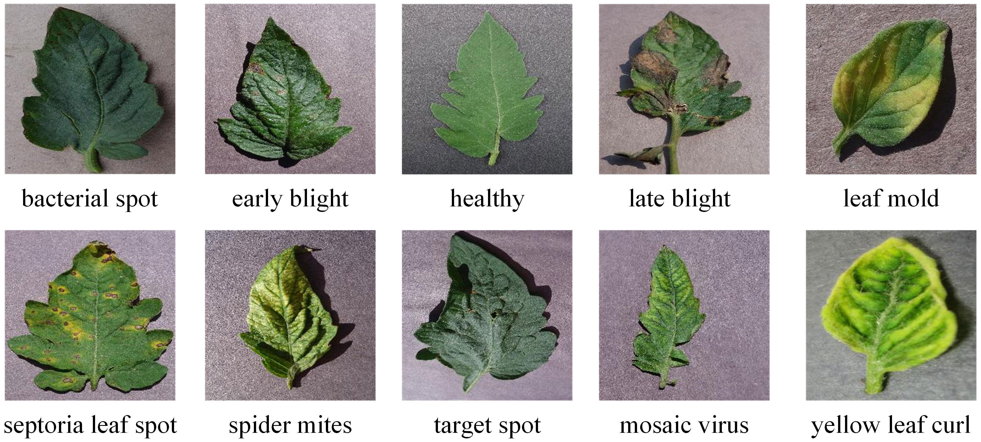
Image Classification: Other Applications
Object Recognition
Optical Character Recognition
Emotion Recognition
Plant Disease Recognition

Slide 36
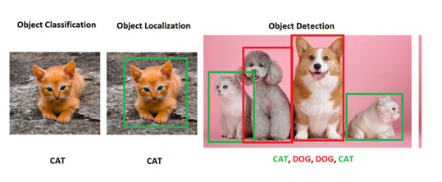
Tasks in Computer Vision
Object Localization:
Definition: Task of identifying precise location of a single object within an image
Output: Bounding box coordinates around the object
Object Detection:
Definition: Task of detecting and localizing multiple objects within an image
Output: List of bounding boxes, each with class label and confidence score

Slide 37
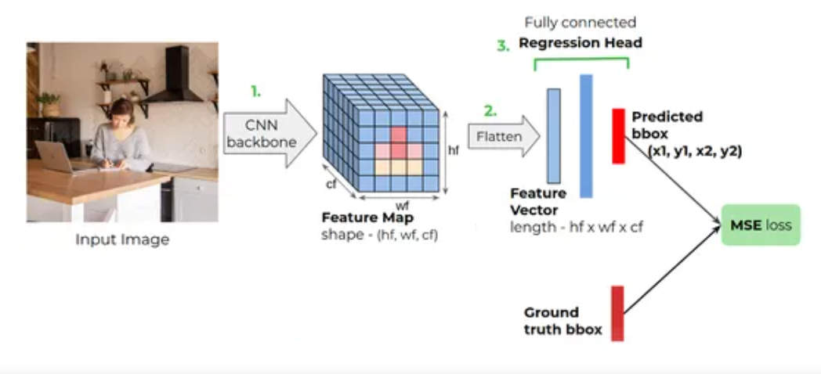
Tasks in Computer Vision
Object Localization:
Definition: Task of identifying precise location of a single object within an image
Output: Bounding box coordinates around the object
The regression head consists of 4 nodes at the end corresponding to the (x1, y1, x2, y2)
To convert the 3D tensor into a vector
Choosing a Standard CNN Architecture
Taken from: https://www.analyticsvidhya.com/blog/2023/06/object-localization-with-cnn-based-localizers/

Slide 38
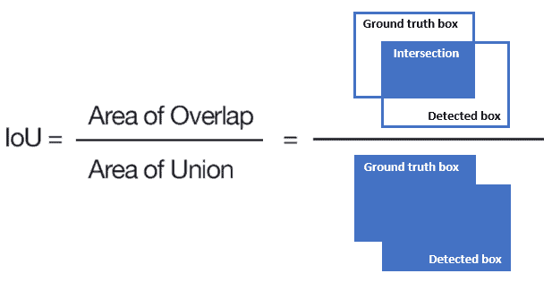
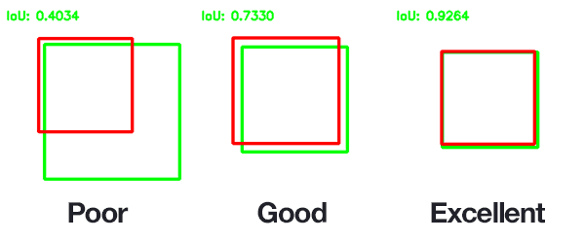
Tasks in Computer Vision
Object Localization:
Definition: Task of identifying precise location of a single object within an image
Output: Bounding box coordinates around the object
Loss function: The MSE loss function can be used in a similar fashion as in the case of other regression tasks.
The MSE is applied between the ground truth bounding box vector and predicted one.
Performance metric: Intersection over Union (IoU) is a common performance metric used in bounding box regression.

Slide 39
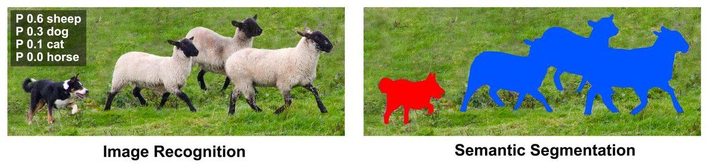
Tasks in Computer Vision
Object Segmentation: Image segmentation is a fundamental task in computer vision that involves partitioning an image into multiple segments or regions based on pixel-level information.
Key Segmentation Techniques:
Semantic Segmentation:
Labels each pixel in the image with a class label, assigning the same label to pixels that belong to the same semantic category.
Taken from: https://wiki.math.uwaterloo.ca/statwiki/index.php?title=User%3AX93ma

Slide 40
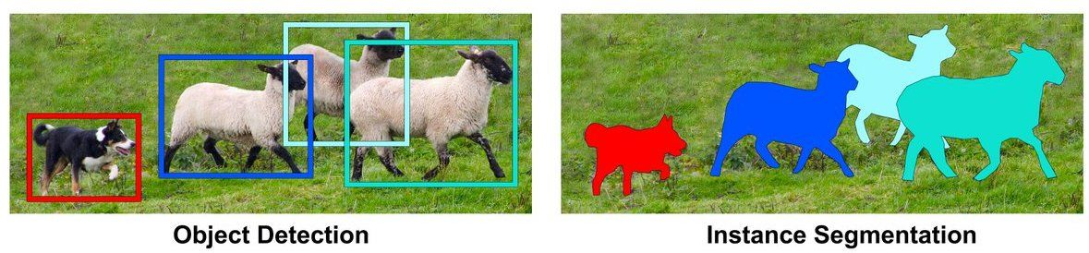
Tasks in Computer Vision
Object Segmentation: Image segmentation is a fundamental task in computer vision that involves partitioning an image into multiple segments or regions based on pixel-level information.
Key Segmentation Techniques:
Instance Segmentation:
Identifies and delineates individual objects within an image, assigning a unique label to each instance of an object.
Taken from https://wiki.math.uwaterloo.ca/statwiki/index.php?title=User%3AX93ma

Slide 41
Tasks in Computer Vision
Object Segmentation: Image segmentation is a fundamental task in computer vision that involves partitioning an image into multiple segments or regions based on pixel-level information.
Key Segmentation Techniques:
Semantic Segmentation:
Labels each pixel in the image with a class label, assigning the same label to pixels that belong to the same semantic category.
Instance Segmentation:
Identifies and delineates individual objects within an image, assigning a unique label to each instance of an object.
Encoder-Decoder Architecture:
Utilizes an encoder network to capture contextual information from input images.
Followed by a decoder network to generate segmentation masks with detailed spatial information.

Slide 42
U-Net Architecture for Semantic Segmentation
U-Net is a Convolutional Neural Network (CNN) architecture designed for semantic segmentation tasks, particularly in the field of biomedical image analysis.
Contracting Path (Encoder):
It captures contextual information and extracting high-level features.
It consists of convolutional layers and pooling operations that progressively reduce the spatial dimensions of the input while increasing the depth of feature maps.
By downsampling the input image, the encoder effectively enlarges the receptive field of the network, allowing it to capture global context and learn hierarchical representations of features.
Original Paper: O. Ronneberger et al., U-Net: Convolutional Networks for Biomedical Image Segmentation, 2015, MICCAI.

Slide 43
U-Net Architecture for Semantic Segmentation
U-Net is a convolutional neural network (CNN) architecture designed for semantic segmentation tasks, particularly in the field of biomedical image analysis.
The Expansive Path (Decoder):
It is responsible for recovering spatial information and generating detailed segmentation masks.
It consists of up-sampling layers and skip connections that progressively increase the spatial resolution of feature maps while retaining rich spatial information.
By upsampling the feature maps from the encoder and concatenating them with feature maps from corresponding layers in the decoder, the decoder enables precise localization of objects and fine-grained segmentation.

Slide 44
U-Net Architecture for Semantic Segmentation
U-Net is a convolutional neural network (CNN) architecture designed for semantic segmentation tasks, particularly in the field of biomedical image analysis.
Bottleneck Layer:
It serves as a bridge between the contracting and expansive paths, capturing the most abstract features of the input image.
It reduces the spatial dimensions of feature maps while increasing their depth.
This compression of high-dimensional feature representations aids in parameter reduction.

Slide 45
U-Net Architecture for Semantic Segmentation
U-Net is a convolutional neural network (CNN) architecture designed for semantic segmentation tasks, particularly in the field of biomedical image analysis.
Skip Connections:
It connects corresponding layers between the contracting and expansive paths, facilitating the transfer of detailed spatial information.
It helps in mitigating the vanishing gradient problem and improving the segmentation accuracy.

Slide 46
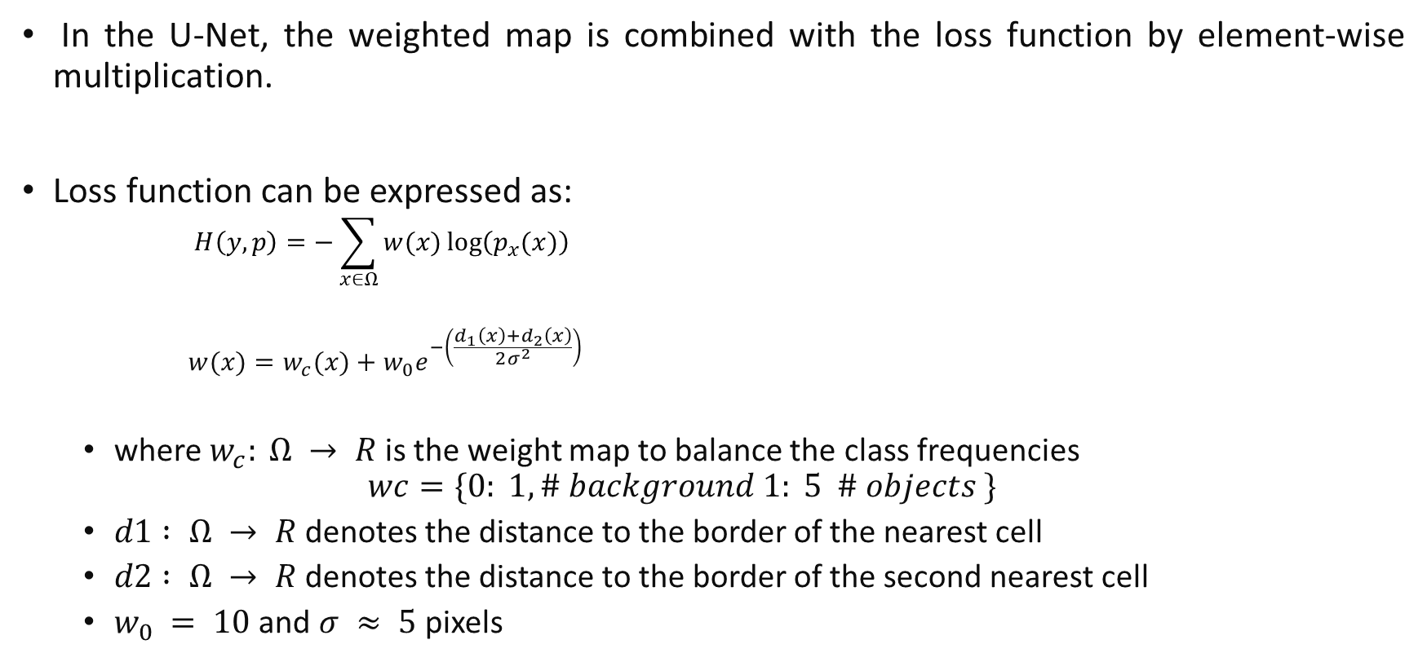
U-Net Architecture for Semantic Segmentation
In the U-Net, the weighted map is combined with the loss function by element-wise multiplication.
Loss function can be expressed as:
$$H\left(y,p\right)=−\sum_{x∈Ω}{w(x)\log\left(p_{x}(x)\right)}$$
$$w(x)=w_{c}(x)+w_{0}e^{−\left(\frac{d_{1}\left(x\right)+d_{2}\left(x\right)}{2σ^{2}}\right)}$$
where $w_{c}: Ω → R$is the weight map to balance the class frequencies
$$wc=\{0: 1, \# background 1: 5 \# objects \}$$
$d1 : Ω → R$denotes the distance to the border of the nearest cell
$d2 : Ω → R$denotes the distance to the border of the second nearest cell
$w_{0} = 10$ and $σ ≈ 5$ pixels
This equation indicates that each pixel-wise cross-entropy loss value is multiplied by the corresponding weight from the weighted map.
This process effectively assigns higher weights to pixels belonging to minority classes, thereby giving them more influence during the training process.

Slide 47
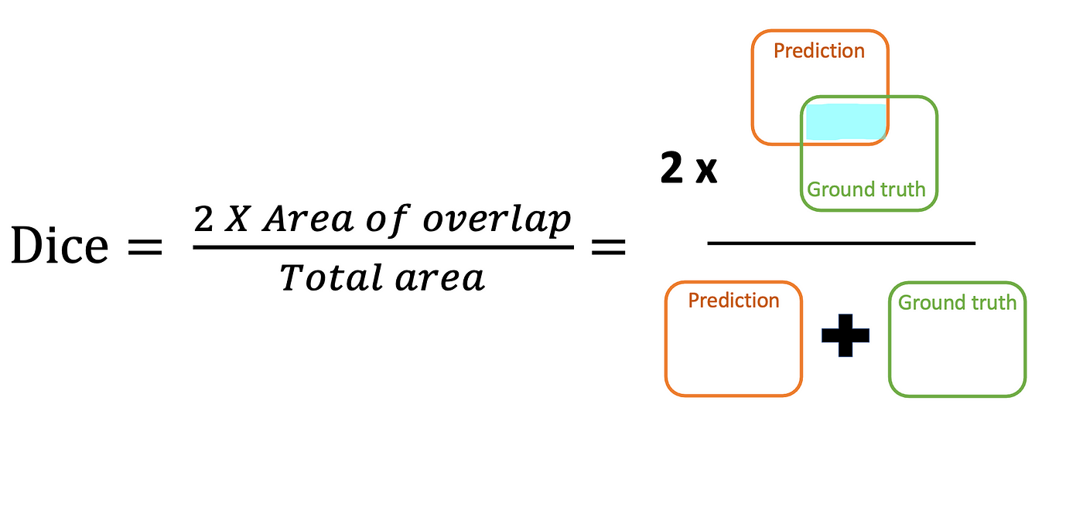
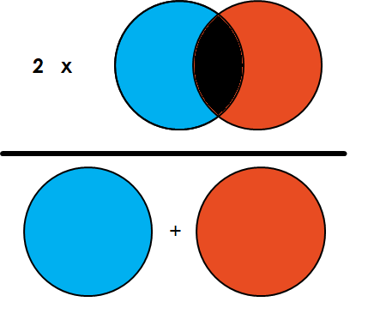
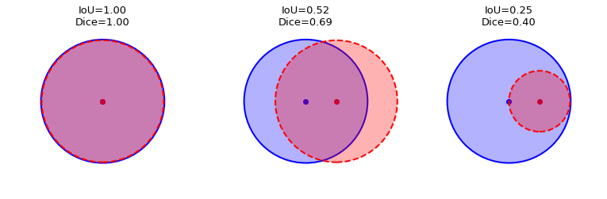
U-Net Architecture for Semantic Segmentation
For evaluating the performance of U-Net or any semantic segmentation model, several evaluation metrics are commonly used to quantify the accuracy and effectiveness of the segmentation results.
Intersection over Union (IoU)
Dice Coefficient

Slide 48
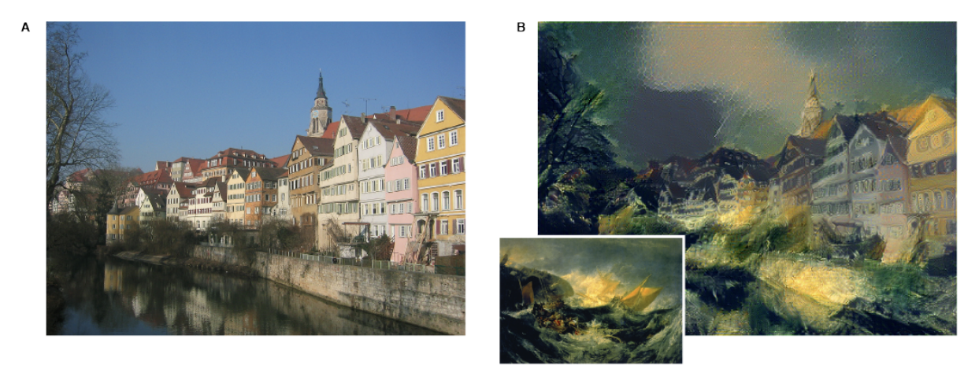
Tasks in Computer Vision
Style Transfer: Style transfer or neural style transfer is the task of learning style from one or more images and applying that style to a new image.
Some papers include:
A Neural Algorithm of Artistic Style, 2015.
Image Style Transfer Using Convolutional Neural Networks, 2016.

Slide 49
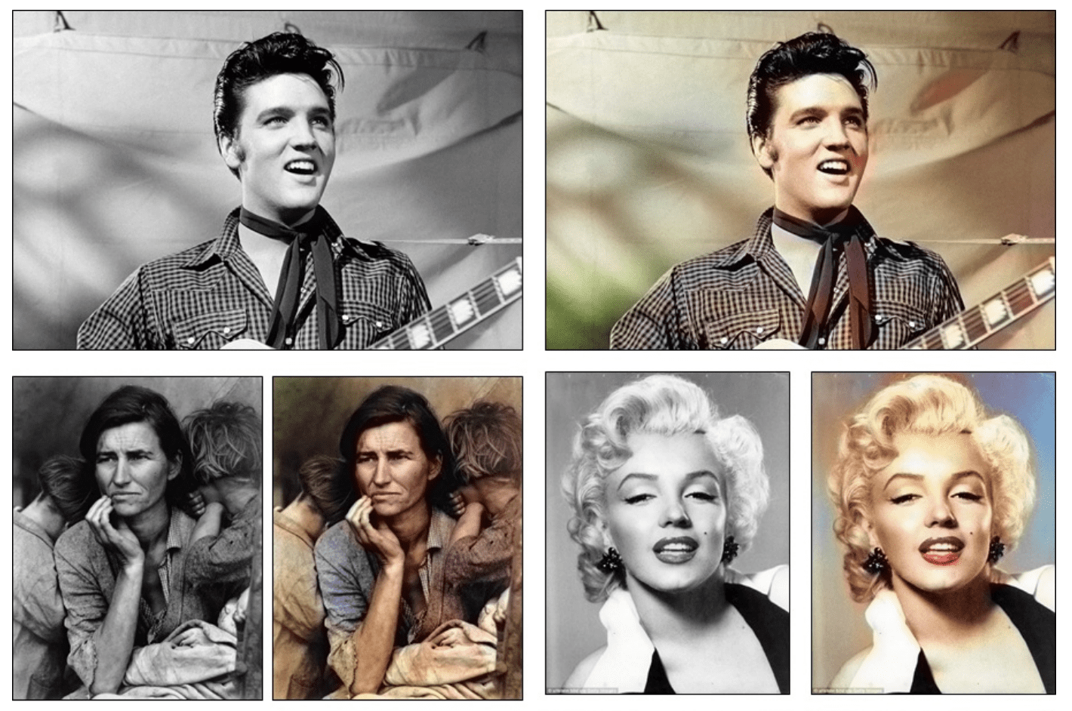
Tasks in Computer Vision
Image Colorization: Image colorization or neural colorization involves converting a grayscale image to a full color image.
Some papers include:
Colorful Image Colorization, 2016.
Let there be Color!: Joint End-to-end Learning of Global and Local Image Priors for Automatic Image Colorization with Simultaneous Classification, 2016.
Deep Colorization, 2016.

Slide 50
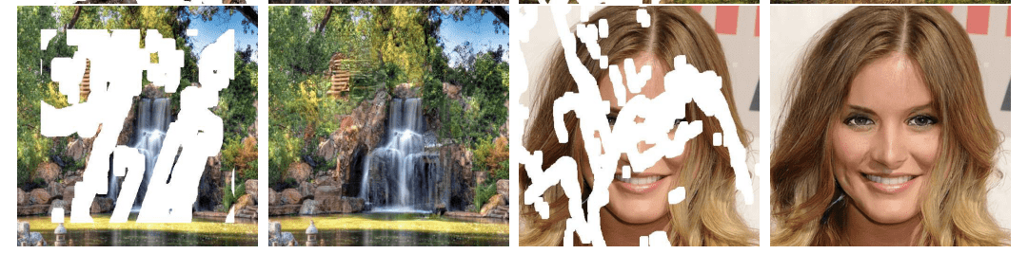
Tasks in Computer Vision
Image Reconstruction: Image reconstruction and image inpainting is the task of filling in missing or corrupt parts of an image.
Some papers include:
Pixel Recurrent Neural Networks, 2016.
Image Inpainting for Irregular Holes Using Partial Convolutions, 2018.
Highly Scalable Image Reconstruction using Deep Neural Networks with Bandpass Filtering, 2018.

Slide 51
Tasks in Computer Vision
Image Captioning: Generating a textual description of an image.
Show and Tell: A Neural Image Caption Generator, 2014.
Image Describing: Generating a textual description of each object in an image.
Deep Visual-Semantic Alignments for Generating Image Descriptions, 2015.
Text to Image: Synthesizing an image based on a textual description.
AttnGAN: Fine-Grained Text to Image Generation with Attentional Generative Adversarial Networks, 2017.
Tracking: Estimating the state of the target object present in the scene from previous information.
Online Multiple Pedestrian Tracking using Deep Temporal Appearance Matching Association, 2020.
3D Object Reconstruction: Inferring the 3D geometry and structure of objects and scenes from one or multiple 2D images.
Image-Based 3D Object Reconstruction: State-of-the-Art and Trends in the Deep Learning Era, 2021.

Slide 52
Introduction to Natural Language Processing
Lecture: Text Classification using CNNs

Slide 53
Outline: Part II
Introduction to text classification
Preprocessing steps for natural language processing
Text classification using convolutional neural network
Experimentation of sentiment analysis using convolutional neural network

Slide 54
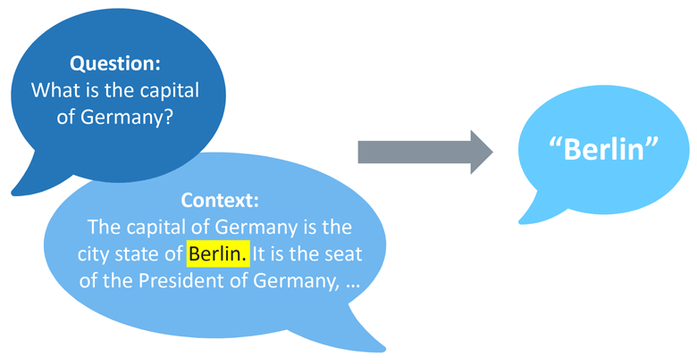


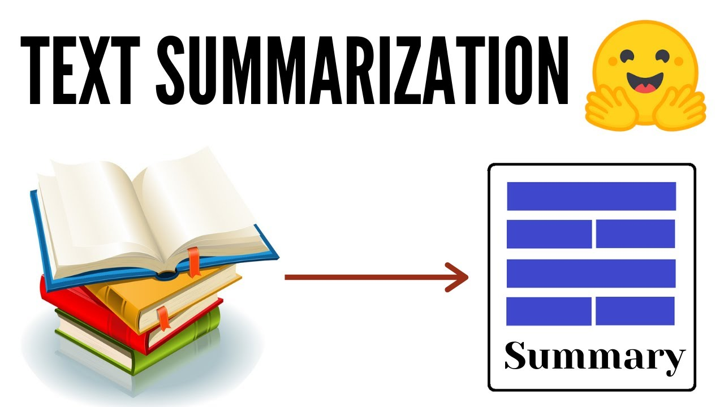
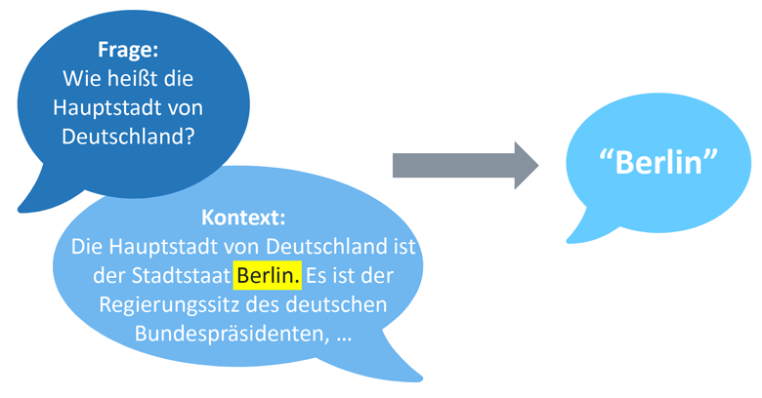
Introduction to Natural Language Processing
Natural Language Processing (NLP):
A branch of Artificial Intelligence (AI) that helps computers understand, interpret, generate and analyze human language.
NLP models are used to solve common language problems, like
Document
summarization
Text classification
Question answering
Text Generation

Slide 55
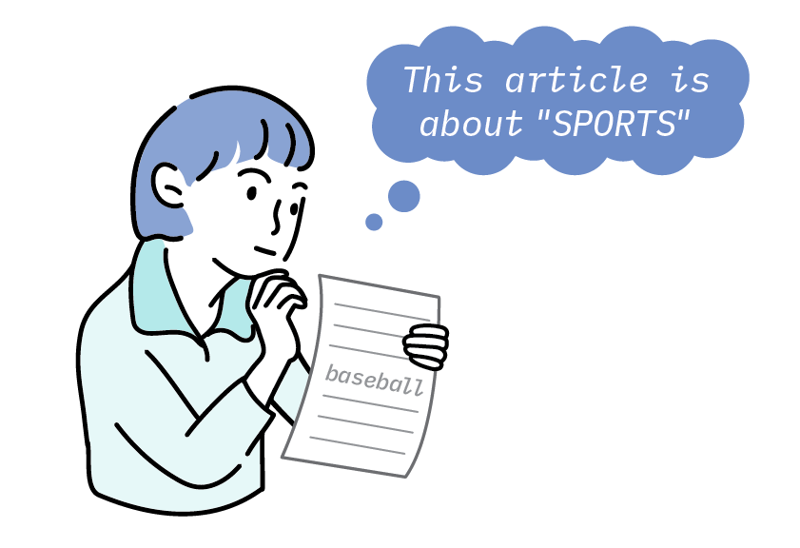
Text Classification: Definition
Definition: Text classification is an NLP task that involves categorizing text data into predefined classes based on its content, context, or sentiment.
Purposes:
automatic labeling,
enabling efficient organization,
retrieval, and
analysis of textual information.

Slide 56
Text Classification: Applications
Applications of text classification:
Spam detection: Classify emails as spam or not spam.
Sentiment analysis: Determine the sentiment of reviews or social media posts.
Topic categorization: Group news articles by subject.
Language detection: Identify the language of a given text.

Slide 57
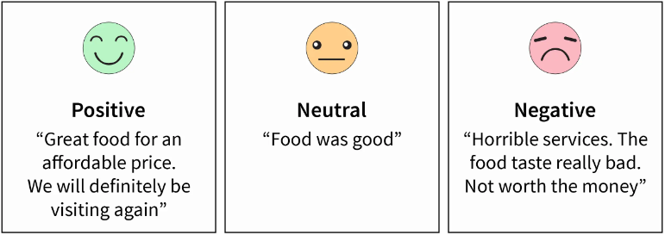
Text Classification: Sentiment Analysis
Example Sentiment Analysis:
Input: text of a review
Output: class of sentiment
e.g., 3 classes: positive, neutral, negative
Positive example:
Great food for an affordable price. We will definitely be visiting again.
Neutral example:
Food was good.
Negative example:
Horrible services. The food taste really bad. Not worth the money.

Slide 58
Text Classification: Challenges
Challenges with text classification:
Unstructured Text: Most information is unstructured poses challenges in analysis, understanding, and organization.
Ambiguity: words may carry multiple meanings based on context, requiring models to grasp nuanced semantics.
Domain-Specific Language: Specialized vocabulary can challenge generalization.
Sarcasm and Irony: Models struggle to identify sarcasm and irony without contextual cues.

Slide 59
Text Classification: Approaches
Rule-Based Approach: Utilize predefined linguistic rules to classify text.
Example:
We want to classify news articles into two groups: Sports and Politics.
First, we will need to define two lists of words that characterize each group:
words related to sports such as football, basketball, LeBron James, etc., and
words related to politics, such as Donald Trump, Hillary Clinton, Putin, etc.
Next, when we want to classify a new incoming text, we will need to count the number of sport-related words that appear in the text and do the same for politics-related words.
If the number of sports-related word appearances is greater than the politics-related word count, then the text is classified as Sports and vice versa.

Slide 60
Text Classification: Approaches
Machine and Deep Learning: Train models on labeled data to learn patterns.
ML tends to rely on hand-crafted features, and
DL leverages neural networks to automatically extract features from data.
Machine Learning (ML)
pre-processing
feature extraction
modeling
positive
Text
token
lemma
stem
BOW
N-gram
SVM
Navie Bayes
output
pad
stop word
…
…
…
Classification
logistic regression
negative
Deep Learning (DL)
pre-processing
modeling
positive
token
lemma
stem
output
Text
Classification
pad
stop word
…
word embedding
convolutional Model
FCL
negative

Slide 61
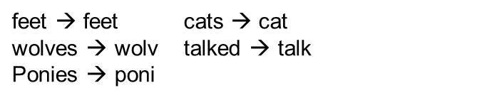
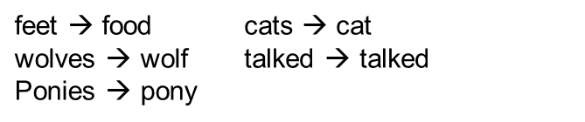
Text Preprocessing
Tokenization: a process that splits an input sequence into so-called tokens.
Original Text: This is Amir’s text, isn’t it?
Tokenized Text: [This, is, Amir, ’s, text, , , is, n’t, it, ?]
Token Normalization: Generating same token for different forms of the word
Stemming: removing and replacing suffixes to get to the root form of the word.
Lemmatization: reducing words to their base or root forms using linguistic rules and vocabulary analysis, known as the lemma.
splitting by a set of rules
fails on irregular forms, produces non-words
Porter’s stemmer
WorldNet lemmatizer: Uses the WordNet database to lookup lemmas

Slide 62
Text Preprocessing
Words Removal: Eliminating common and frequently occurring words (like "and," "the," "is") that don't contribute much to the meaning of the text.
Removing Unnecessary Elements: Discarding special characters, punctuation, and symbols that may add noise to the text and hinder analysis.
Integer Encoding: Converting words/tokens into unique integer values, enabling numerical representation for machine learning models.
Padding: Ensuring that all sequences have the same length by adding padding (usually zeros) to shorter sequences.
This is necessary for consistency when training deep learning models.

Slide 63
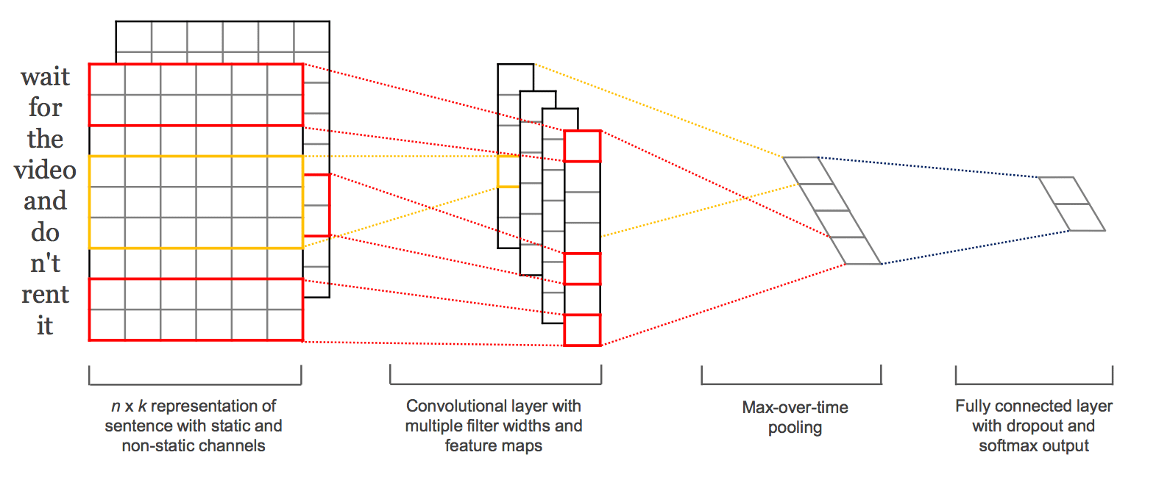
Text Classification using CNN
Generally, the Convolutional Neural Network (CNN) architecture for text classification is comprised of three key elements:
Word embedding: a process of converting tokens into dense and continuous vector representations in a high-dimensional space.
Convolutional model: a feature extraction model that learns to extract salient features from texts represented using a word embedding.
Fully connected model: an interpretation of extracted features in terms of a predictive output.
An example of a CNN Architecture for Natural Language Processing. Taken from “Convolutional Neural Networks for Sentence Classification”, 2014.

Slide 64
Word Embedding
Machine/deep learning models take arrays of numbers as input.
When working with text, the first step is to find out a strategy to convert strings to numbers before feeding it to the model.
To achieve this, each word is encoded using a unique number in the preprocessing.
Consider the sentence "The cat sat on the mat". vocabulary list (cat, mat, on, sat).
In this manner, we could assign 1 to "cat", 4 to "mat", and so on.
we could then encode the sentence as a dense vector like [1, 4, 3, 2].
Problem: There are one main problems with this approach:
The integer-encoding does not capture any relationship between words.
Solution: word embedding

Slide 65



Word Embedding
Word embeddings is a representation for text where words that have the same meaning have a similar representation.
It represents words as dense vectors in a high-dimensional space, typically of tens (for small datasets) to several hundred (for large datasets) dimensions.
Higher dimensions can capture fine nuances (fine-grained relations) but require more data.
Each word is represented as a 4-dimensional vector
king | man | queen | woman
0.99 | 0.2 | 0.99 | 0.3
0.99 | 0.99 | 0.05 | 0.05
0.05 | 0.05 | 0.99 | 0.99
0.7 | 0.7 | 0.6 | 0.6
Mathematically: $sim(A,B)=cos⁡(θ)=\frac{A.B}{\left\|A\right\|\left\|B\right\|}$
king - man + woman = ?
0.99
0.99
0.05
0.7
0.3
0.99
0.05
0.7
0.3
0.05
0.99
0.6
-
+

Slide 66
Word Embedding
An embedding is a dense vector of floating-point values.
These values are learnable parameters (weights), adjusted during model training.
There are two main options to learn word embedding:
Learn Jointly: embedding is learned as part of a large task-specific model.
This is a good approach if we only intend to use the embedding on one task.
Learn Standalone, where a model is trained to learn the embedding, which is saved and used as a part of another model.
Existing models: GloVe and word2vec
Advantages:
capture sematic relationship between words, and
help CNN models to understand the meaning of words in the text.

Slide 67

Convolutional Model
CNN model for text Classification

Slide 68



1D Convolution
1D convolution is a process of sliding a kernel filter over a text sequence.
kernels filters with height of $h$, effectively capture patterns in sequential groups of $h$ words.
width=
Length of embedding
this
height=
Number of words to look at in sequence
movie
has
amazing
diverse
characters
Feature vector

Slide 69

1D Convolution
At each step, a weighted sum is computed between the filter and the contextual window.
The result of this operation captures local patterns and features present in the text and enable model to detect important combinations of words.
A CNN model will include many filters, and, as the network trains, filter weights are learned.
embedding
width=
Length of embedding
the
height=
Number of words to look at in sequence
good
movie

Slide 70

1D convolution
There is another nice property with this 1D convolutional operation:
similar words will have similar embeddings and a convolution operation is just a linear operation on these vectors.
convolutional kernel has learned to capture a more general feature; not just a good movie or song, but a positive thing.

Slide 71



Activation Function in Convolutional Layer
Activation functions introduce non-linearity to the model.
Generally, the Rectified Linear Unit (ReLU) is employed as an activation function.
$$ƒ(x) = max⁡(0,x)$$
Word embedding
this
movie
has
convolution
ReLU
amazing
diverse
characters

Slide 72
Max Pooling over Time
In text classification context, Max Pooling over time follows 1D convolution to extract crucial local features, disregarding positional details.
Example:
If we are trying to classify movie reviews, and we see the phrase, “great plot,” it doesn’t matter where this appears in a review; it is a good indicator that this is a positive review, no matter its location in the source text.
Advantages:
Reduce dimensions of feature map,
Extracts the most important information, and
Making the model robust to variations in word order and position in the text.
this
movie
has
convolution
maxpooling
amazing
diverse
characters

Slide 73










Fully Connected Model
Finally, we have a multi-layer neural network with an activation function such as softmax or sigmoid in output layer to generate the classification output.
Binary Classification
Binary Cross Entropy
Model
$$sigmoid\left(x\right)=\frac{1}{1+e^{−x}}$$
$$f\left(s\right)$$
$$t_{1}$$
$$x$$
$$CE={−t}_{1}\log\left(f\left(s\right)\right)−\left(1−t_{1}\right)log⁡(1−f\left(s\right))$$
CNN
Ground Truth
Output
$$softmax\left(x_{i}\right)=\frac{e^{x_{i}}}{\sum_{c=1}^{m}{e^{x_{c}}}}$$
$$f\left(s_{i}\right)$$
$$CE=−\sum_{i}^{C}{t_{i}log⁡(f\left(s_{i}\right))}$$
$$x_{i}$$
$$t_{i}$$
Multiclass Classification
Cross Entropy

Slide 74
Hyperparameters
Word embedding:
Number of feature maps:
[10-300] for small datasets and
[100,1000] for large datasets.
Convolutional layer:
Kernel size: reasonable range might be [2, 10].
Number of filters: reasonable range might be [32, 512].
Fully connected layer:
Number of neurons in hidden layer must be less than the input convolutional features.
This is the process of searching for the best model parameters programmatically.
Grid search can be used to perform an exhaustive search over the given parameters.

Slide 75

Implementation
Yelp Restaurant Reviews Data
We implement the following model
randomly selected hyperparameters:
number of feature maps: 10
kernel size: 5,
number of filters: 128
number of neurons in hidden layer: 10
Use grid search to optimize hyperparameters of the model.
Train the model with the best hyperparameters.
"encoding_size":[10, 20, 60, 100],
"kernel_size":[2, 3, 4, 5, 7],
"num_filters":[32, 64, 100, 128],
"neuron_size":[8, 10, 15, 20],

Slide 76


Implementation
Evaluation Metric: $accuracy=\frac{TP+TN}{TP+TN+FP+FN}$
True Positive (TP): Correctly predicted positive instances.
True Negative (TN): Correctly predicted negative instances.
False Positive (FP): Incorrectly predicted negative instances.
False Negative (FN): Incorrectly predicted positive instances.
The model with random parameters provides 70.99% accuracy on the test samples.
The model parameters optimized using grid search:
The best parameters:
The model with the best parameters provides 75.49% accuracy on the test data.
"encoding_size":[10, 20, 60, 100],
"num_filters":[32, 64, 100, 128],
"kernel_size":[2, 3, 4, 5, 7],
"neuron_size":[8, 10, 15, 20],
'encoding_size’: 100, 'kernel_size’: 2, 'neuron_size’: 8, 'num_filters': 64

Slide 77
References
Computer Vision: Algorithms and Applications, R. Szeliski, Springer, 2010.
Deep Learning, I. Goodfellow, Y. Bengio, and A. Courville. MIT Press, 2016.
Deep Learning for Computer Vision with Python, Adrian Rosebrock, PyImageSearch, 2017.
Advanced Methods and Deep Learning in Computer Vision, E.R. Davies and Matthew Turk, ‎ Academic Press, 2021.
Natural Language Processing Succinctly, J. D. Booth, Syncfusion, 2018.
Deep Learning for NLP and Speech Recognition, U. Kamath, J. Liu, and J. Whitaker, Springer, 2019.
Deep Learning for Natural Language Processing, Stephan Raaijmakers, Manning Publications, 2022.

Slide 78
Thank you for listening

